Slide 1

Feature-Based Used Car Price Predictor Using Linear Regression and Support Vector Machines
By Parker Smith

Slide 2
Outline
Introduction and Motivation: What is the problem and why am I solving it?
Description and Details: A general description of the problem, the solution, and the results.
Extensive Results: A display of the results from this project including
How I gathered data
The performed tests
My key results
Conclusions and Future Work: What do these results show and how can this project be extended in the future?

Slide 3
Introduction and Motivation
Purchasing a car is the second largest purchase most people make.
Since the average price of a new car is $46,426 and the average price of a used car is $30,000, a large portion of the population has turned to purchasing used cars [1].
However, determining whether a listed price is fair and accurate is a more difficult task.
In the past, a consumer, car salesmen, or private car seller would have to manually search through other car listings and (with their bias included), determine whether the price listed was accurate. This leads to inaccurate and time-consuming results.
This problem can be greatly simplified through machine learning.

Slide 4
Project Description and Details
This project is based off CS 229 Project Report: Predicting Used Car Prices by Kshitij Kumbar, Pranav Gadre, and Varun Naya [2]. MORE INFO ABOUT WHY THE BASELINE IS BAD
In this project, I simply use a Support Vector Machine (SVM) and Multiple Linear Regression.
The dataset for this project comes from Kaggle and includes 560,000 car listings [3].
This project runs the dataset through each model a single time and returns the R² Accuracy, the Mean Squared Error (MSE), the Root Mean Squared Error (RMSE), and the time it took to train the model.
My initial models showed great success, with both taking less than a minute to train and having an R² accuracy of over 90%.

Slide 5
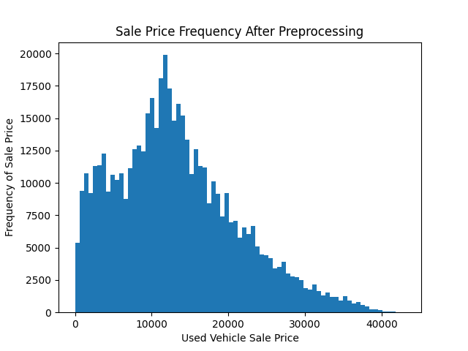
Extensive Results – The Dataset
The dataset chosen for this project from Kaggle included 4 continuous factors and 12 categorical factors, the most important include the vehicle’s year, make, body style, transmission, condition, odometer reading, and selling price.
Once the dataset was selected, I had to preprocess the data to remove outliers and clean up unnecessary factors.

Slide 6
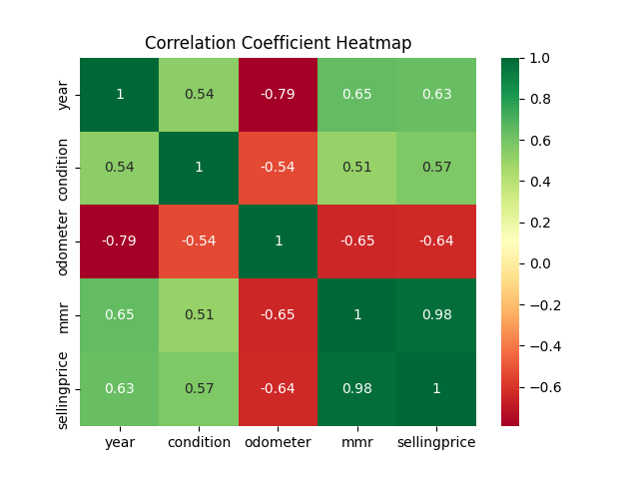
Extensive Results – The Dataset
After preprocessing the data, the categorical features were encoded using the OneHotEncoding scheme. This translates categories into binary features and overall adds more features to the dataset.
Finally, before testing, I determined the linearity of the dataset’s features by comparing several of the continuous features to the sale price.

Slide 7
Performed Tests – Linear Regression
The first model I chose, due to the high linearity of the data, was a Multiple Linear Regression model.
Using 4 continuous features and 8 categorical features, the Linear Regression model ran with a 90% training and 10% testing split on a single epoch.
The accuracy of the model is measured using R² accuracy, MSE, RMSE, and training time.

Slide 8
Performed Tests – SVM
The second model I chose, due to its heavy use in machine learning, was a linear SVM model.
This model also used 4 continuous features and 8 categorical features like the Linear Regression model. It ran with a 90% training and 10% testing split.
The SVM model used a linear kernel to emulate linear regression, the tolerance value for the SVM was set to be .075.
Finally, before any data was inputted to the SVM, it had to be standardized to be between -1 and 1.
The accuracy of the model is measured using R² accuracy, MSE, RMSE, and training time.

Slide 9
Results

Slide 10
Results (cont.)

Slide 11
Conclusion
Conclusion from Paper

Slide 12
Future Work
Future Work from paper

Slide 13
Works Cited
[1] C. Isidore, “Why car prices remain so stubbornly high,” CNN Business, 2022. [Online]. Available: https://www.cnn.com/2022/01/20/business/car-prices-easing-2022/index.html
[2] K. Kumbar, P. Gadre, and V. Nayak, “Cs 229 project report: Predicting used car prices,” December 2019. [Online]. Available: https://cs229.stanford.edu/proj2019aut/data/assignment_308832_raw/26612934.pdf
[3] B. Tunguz, “Used car auction prices,” 2015. [Online]. Available: https://www.kaggle.com/tunguz/used-car-auction-prices

